Slide 1
Artificial Intelligence for All
Kudriashov Nikita
Oğul ÜNAL
Applications & Workflow

Slide 2
How do we do ML project?
There are several crucial steps in every different Machine Learning project where you must teach the computer as if its a child.
Be patient because finding the optimal and ideal solution will take time.
The most important ‘thing’ to teach is your data.
Remember, if you read the wrong book, you will mislead yourself.
This means you can accidentaly misguide your program if you don’t know what is your data about.
Having lots of data might not help or improve your results all the time.

Slide 3
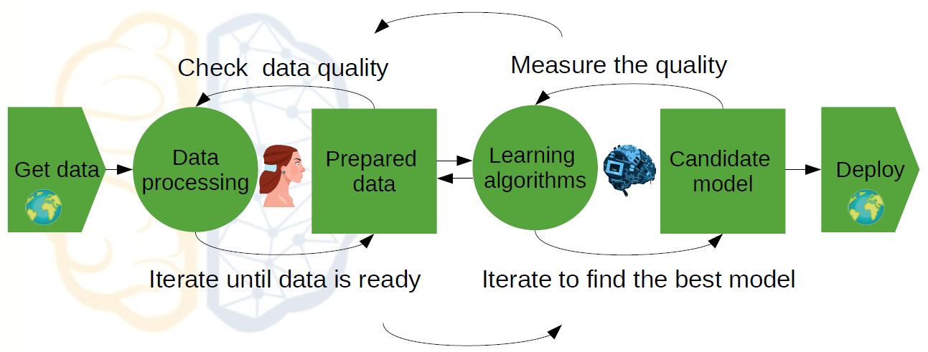

Slide 4

Very well known examples

Slide 5
You may use the following link to check AI experiments in many fields using different AI fields such as image, speech or pattern recognition.
https://experiments.withgoogle.com/collection/ai
https://experiments.withgoogle.com/cartoonify
https://experiments.withgoogle.com/emoji-scavenger
https://experiments.withgoogle.com/freddiemeter
https://experiments.withgoogle.com/sketch-rnn-demo
https://experiments.withgoogle.com/quick-draw

Slide 6
Applications of ML
Linear Regression
Support Vector Machines (Supervised Learning)
Decision Trees & Random Forests (Supervised Learning)
Unsupervised Learning (K-means)
Unsupervised Learning (PCA)
Reinforcement Learning
Neural Networks
Convolutional Neural Networks
Generative Adversarial Networks
Recurrent Neural Networks & Natural Language Processing
Transfer Learning
Ensemble Learning

Slide 7
Linear Regression (Supervised Learning)
Linear regression is used for finding linear relationship between target and one or more predictors. There are two types of linear regression- Binary and Multiple.
Binary is usefull when we want to find the relationship between 2 continuous variables.
Multiple is usefull when we have more than 2.
The core idea is to obtain a line that best fits the data. The best fit line is the one for which total prediction error (all data points) are as small as possible. Error is the distance between the point to the regression line.

Slide 8
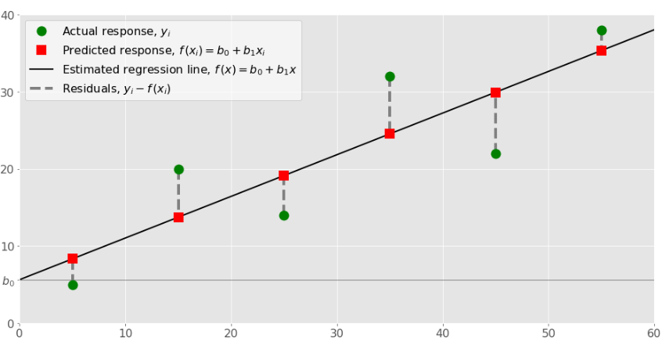
Several examples are:
Engine performance from test data in automobiles.
Prediction of house prices in a city.
Marketing effectiveness, pricing and promotions on sales of a product.

Slide 9
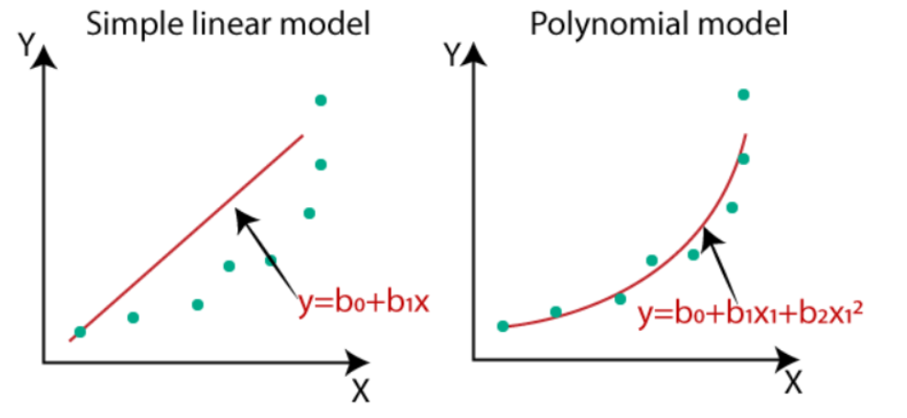

Slide 10
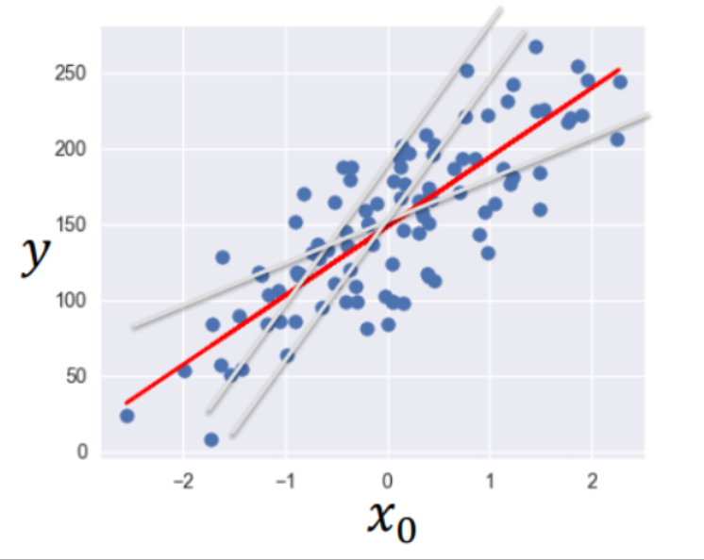
Linear regression performs the task to predict a "dependent" variable value (y) based on a given independent variable (x). So, this regression technique finds out a linear relationship between x (input) and y(output) - y=wx+c

Slide 11
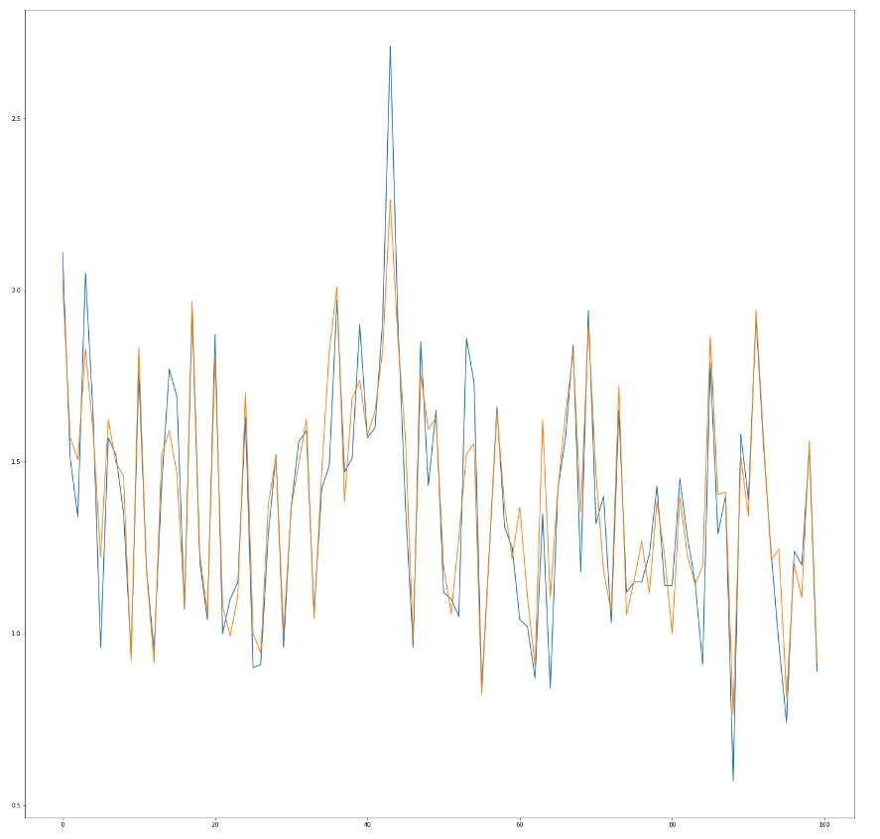
Blue is the real data values, orange is your ML model prediction, trying to make predictions.

Slide 12
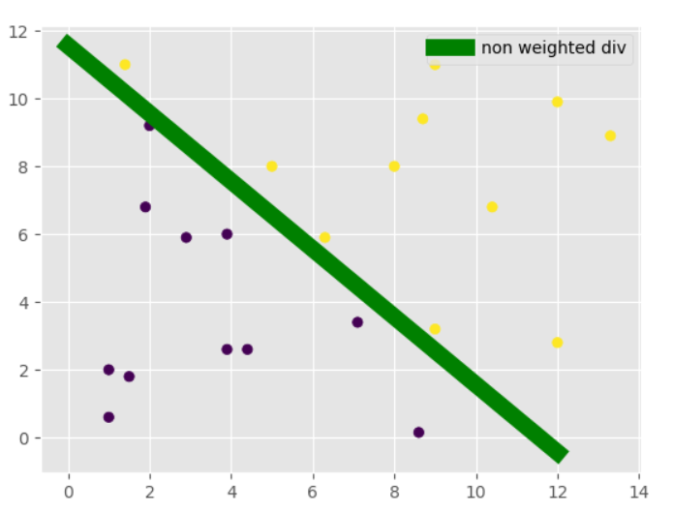
Support Vector Machines (Supervised Learning)
We can use SVM’s to perform classifications. There are libraries that you may use in your code to implement SVM into your Machine Learning model.
A very simple explanation; SVM draws a line between groups.

Slide 13
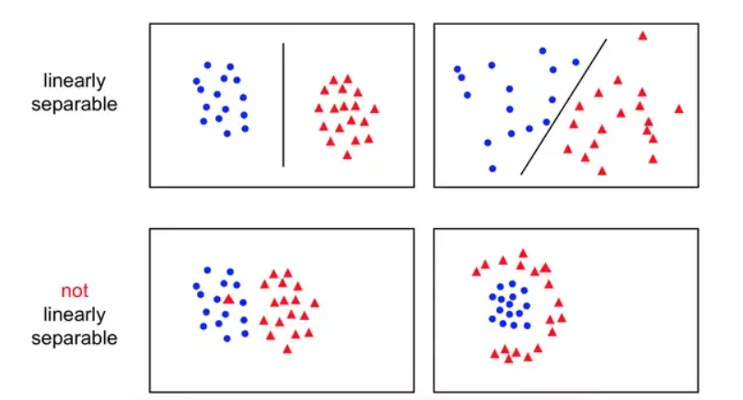
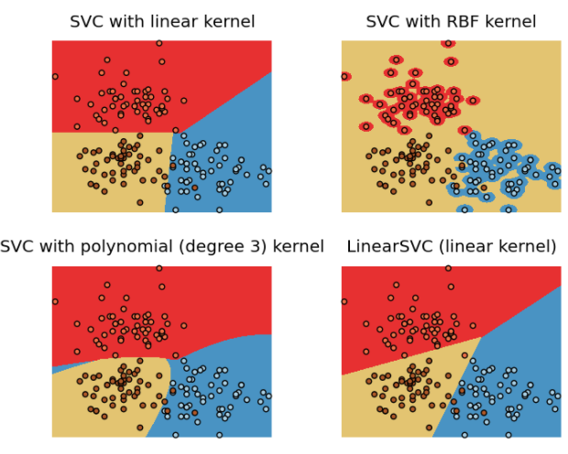
You are hired as ML specialist in a bank, Bank is trying to detect a banknote is fake or not. You have data(parameters that may indicate the banknote is fake or else). You decided to use SVM and perform «binary» classification. (Binary means 2 different classes. Can be more than 2 in other situations.
Remember, SVM can be a linear line(previous slide) or can be non-linear or polynomial.

Slide 14
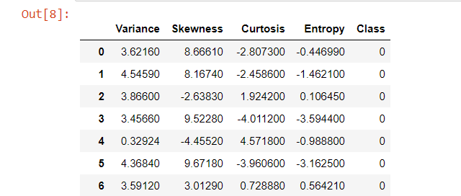
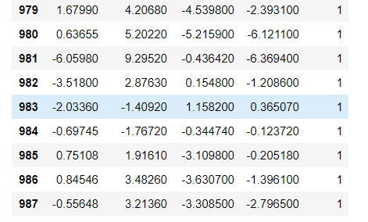
Overview of your Data 0 indicates real, 1 indicates fake. You teach the computer using these columns therefore the computer can classify the new banknote according to it’s Variance, Skewness, Curtosis and Entropy.

Slide 15
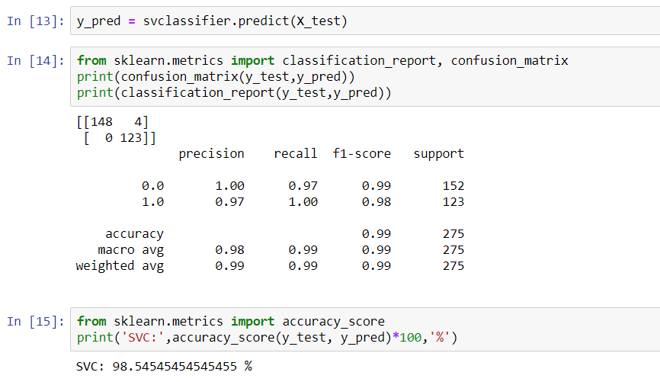
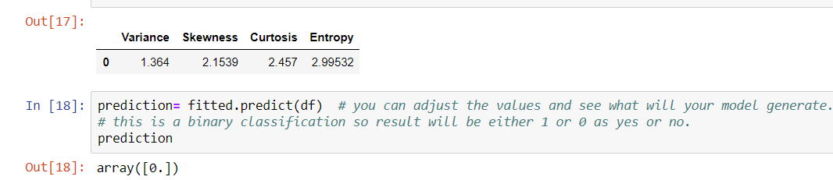

Slide 16
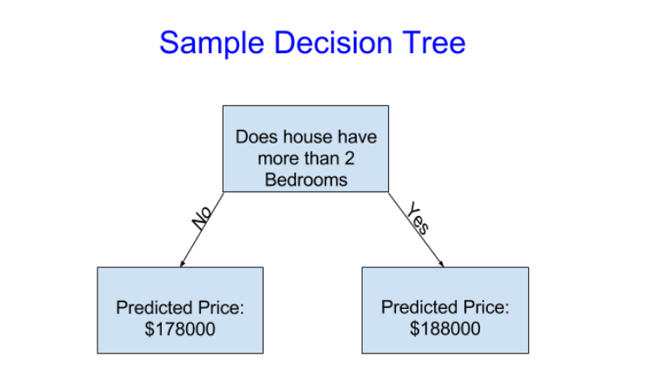
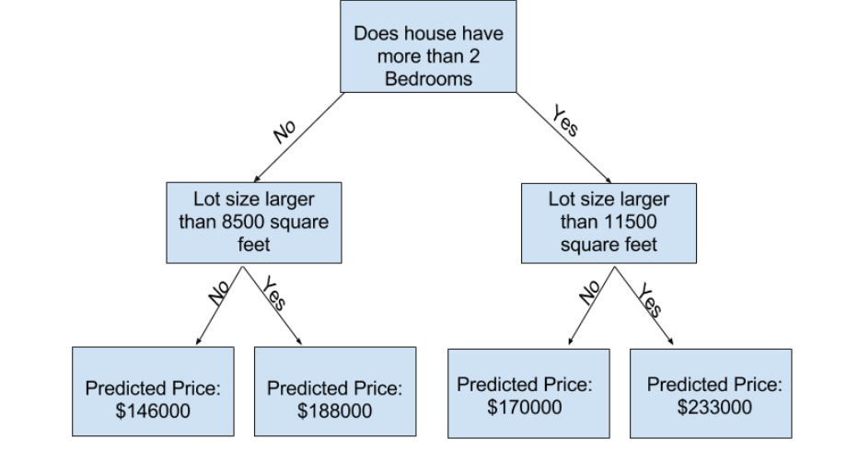
Decision Trees & Random Forests (Supervised Learning)
A decision tree is a decision support tool that uses a tree-like graph or model of decisions and their possible consequences, including chance event outcomes, resource costs, and utility. It is one way to display an algorithm that only contains conditional control statements.

Slide 17
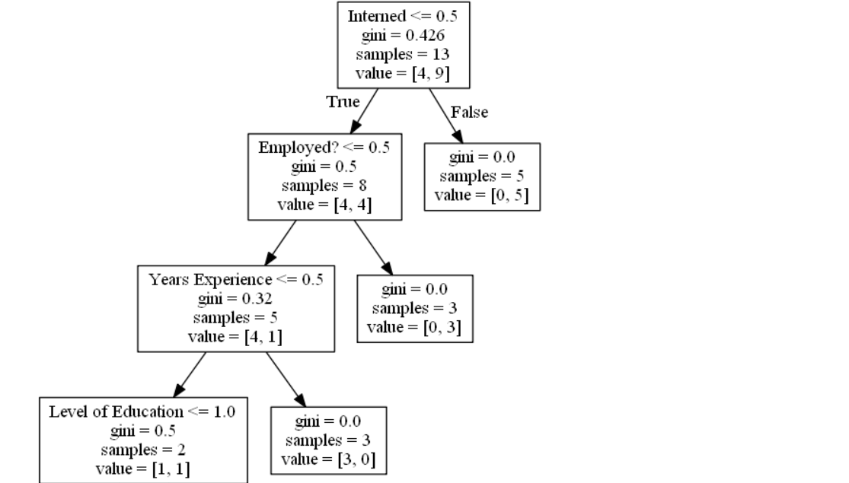

Slide 18
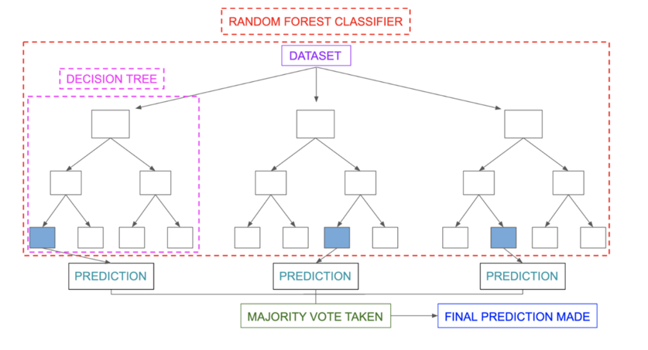

Slide 19
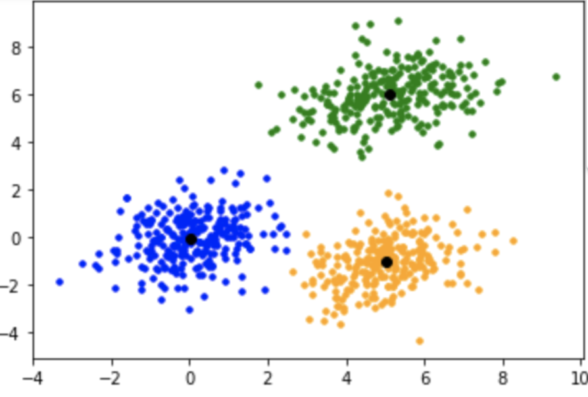
This is an ideal clustering using K-means algorithm. Explanation: When you don’t know anything about your data but you have a data without any determined classes or groups, this means it’s an unsupervised learning. We use k-means to rediscover these clusters in unsupervised learning:
K-Means (Unsupervised Learning)

Slide 20
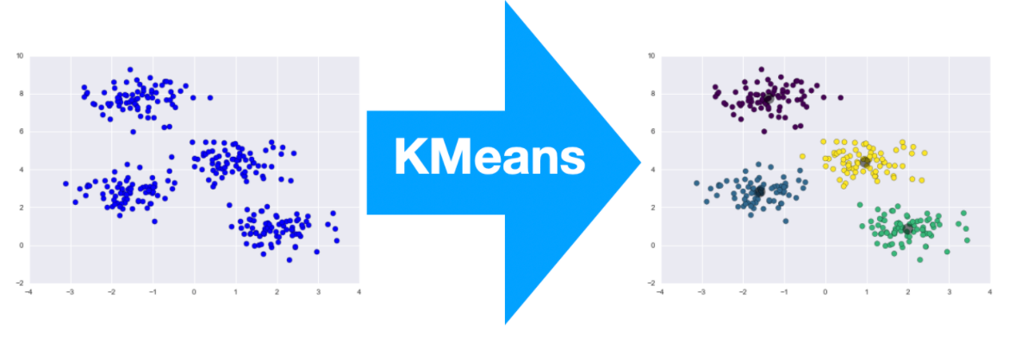
This component is used to assign unlabeled data points to clusters based on a distance-based similarity between observations. k-means clustering is commonly used in signal processing and in feature learning where the output is used as input in different classification algorithms, such as a support vector machine or logistic regression.

Slide 21
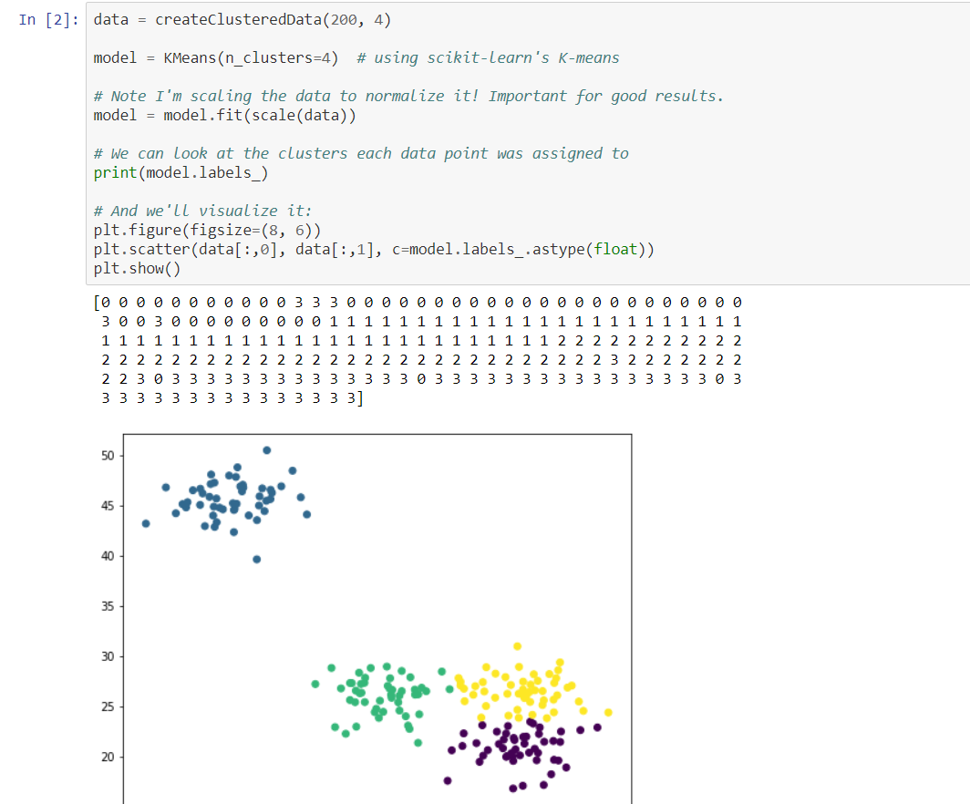
Python code overview of K-Means

Slide 22
PCA(Unsupervised Learning)
PCA is a dimensionality reduction technique; it lets you distill multi-dimensional data down to fewer dimensions, selecting new dimensions. Think of summarizing your data without destroying it «too much»
Check the link below and choose PCA and MNIST data.
You will have many many features in your data
The features will make your data multi-dimensional
PCA can reduce it for you.
http://projector.tensorflow.org/

Slide 23
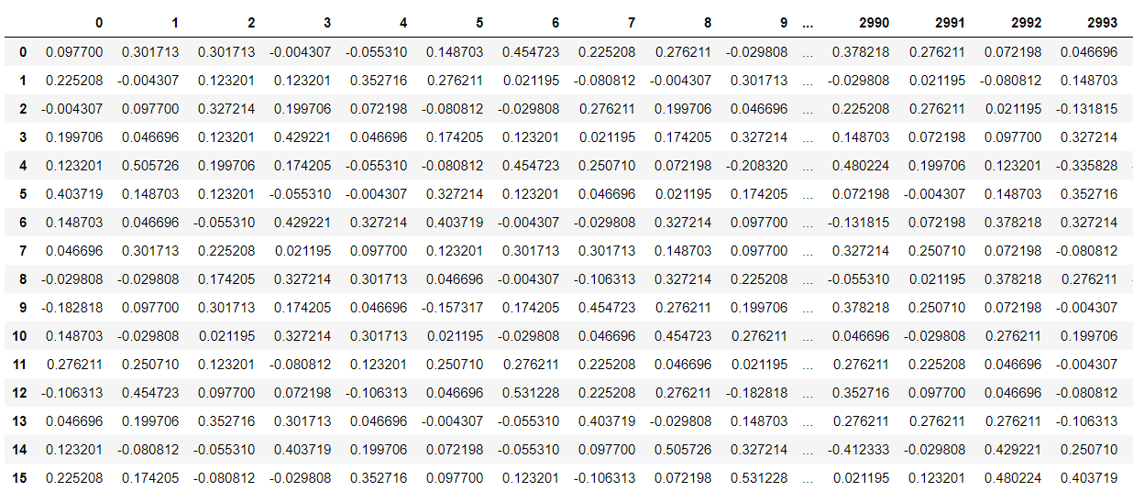
This is how a dataset with 3000 features(columns or dimensions) looks like:

Slide 24
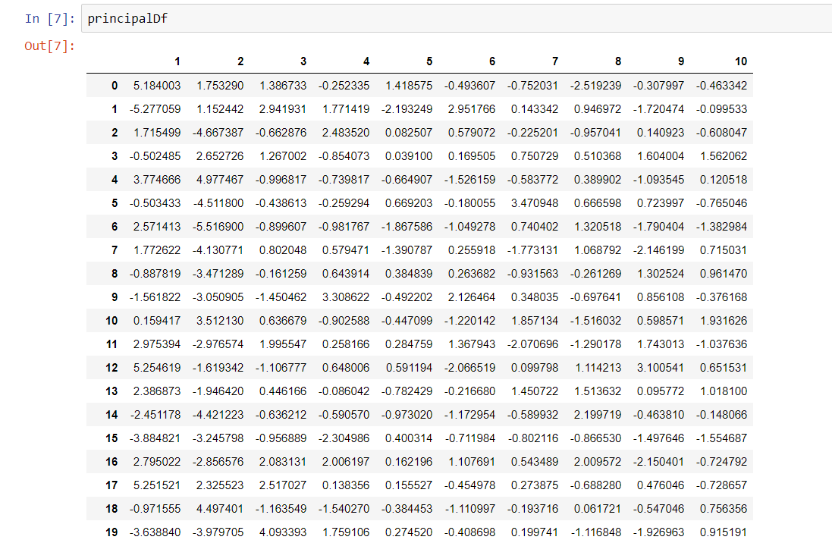
Using PCA I made it 10 dimensional Preferably it’s not Ok to have 3000 dimensional data in your Model.

Slide 25
Reinforcement Learning
We will analyse the python code together (not coding just explanation) to understand Reinforcement Learning.
Reinforcement learning is the training of machine learning models to make a sequence of decisions.
This means I have goals or I can punish my algorithm to make my model’s decisions better
Simple example: Mathematically: I give -1 value into equation everytime a self-driving car gets near to another car. Or I can reward my algorithm by giving +1 when it starts decelerating near Red traffic light sign.
As you can see, This field is perfect for self-driving cars & robotics.
We use environment to reward or punish the algorithm’s behavior( punishing will be only mathematically)

Slide 26
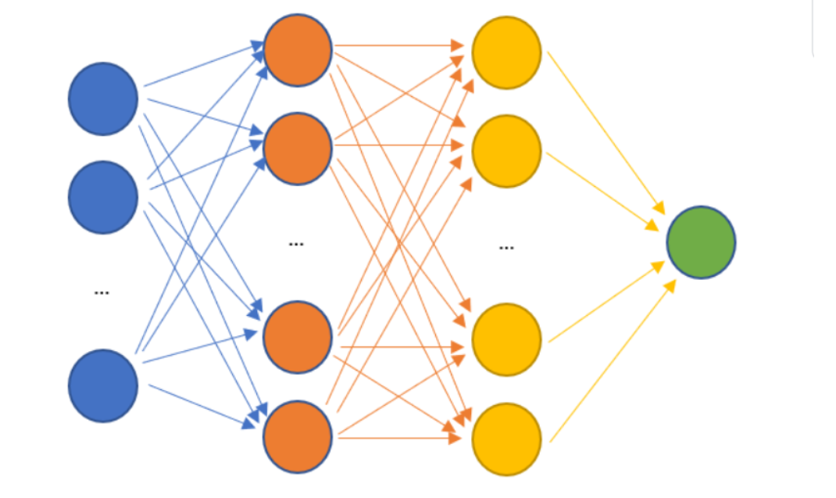
Neural Networks
https://playground.tensorflow.org/
Use this link to discover and build your own NN, play with variables, features and see what you can do.

Slide 27
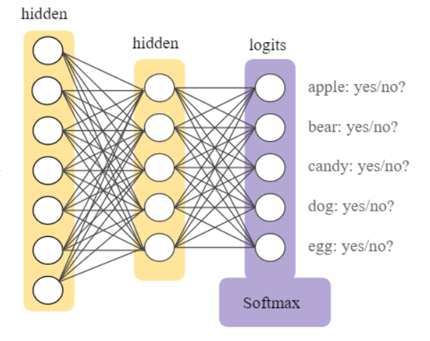

Slide 28
Our brain is actually a very powerful Neural Network.
We have nodes as neurons and they are connected to each other.
Each neuron has activation which will affect the connected neurons in advance.
This can give us a very flexible, self-learning model to perform learning.
You can have different numbers of neurons or layers(its all your choice and it will affect your destiny)
There are specific activation functions that you should choose them wisely ( some of them for binary classification(sigmoid) some of them for multi-class classification(softmax)
We will analyse the code together for you to understand how it works visually.
Use another presentation for more info: Introduction to Neural Networks

Slide 29
Convolutional Neural Networks
Cars recognizing road signs, Instagram recognizes your friends, face recognition apps. Magic? No, CNN.
CNN is another type of neural network like a multi-layer perceptron.
CNNs are able to extract the features of an image, which an algorithm like a multi-layer perceptron (MLP) or a recursive neural network (RNN) does not have the ability to do!
Convolution comes from the Latin convolvere, “to convolve” means to roll together. Convolution is a mathematical operation on two functions (f and g) to construct a third function that represents how the shape of one is modified by the other.

Slide 30
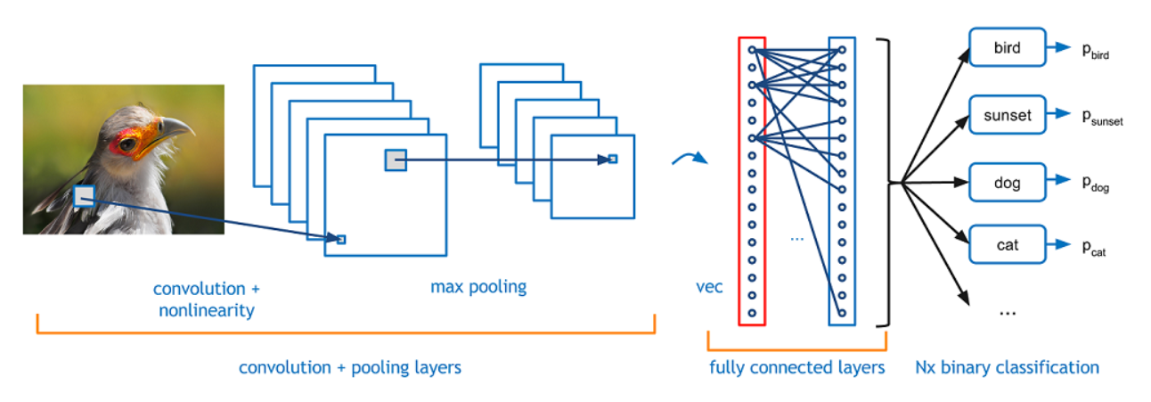
A CNN architecture

Slide 31
Social media is all about CNN. Platforms that are heavily dependent on image processing are using alot of CNN. We are not going to cover video processing although for a quick information; to deal with video processing, there is Tube Convolutional Networks(Tube-CNN)

Slide 32
Image classification is the task of taking an input image and outputting a class (a cat, dog, etc) or a probability of classes that best describes the image. For humans, this task of recognition is one of the first skills we learn from the moment we are born and is one that comes naturally and effortlessly as adults.
A question, How do you think your brain classifies objects or images so fast and accurate?
When the eyes are open, visual information flows from the retina through
the optic nerve and into the brain, which assembles this raw
information into objects and scenes.

Slide 33


Slide 34
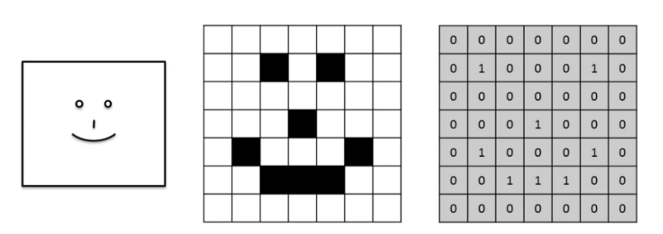
How do computers see?
A very important information: an image is a matrix of pixels. If there is a black and white image, then we will get a 2D array. While, if we passed a colored image, then we will get a 3D array, which means it has an extra parameter for depth which is RGB(Red,Green,Blue) channel as shown below. The pixel value lies between 0 and 255, and images are stored in bytes (0 to 255).

Slide 35
Generative Adversarial Networks
Generative Adversarial Networks, or GANs for short, are an approach to generative modeling using deep learning methods, such as convolutional neural networks.
Generative modeling is an unsupervised learning task in machine learning that involves automatically discovering and learning the regularities or patterns in input data in such a way that the model can be used to generate or output new examples that plausibly could have been drawn from the original dataset.

Slide 36
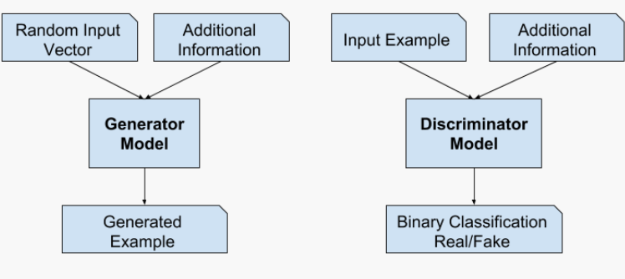
Example of a Generative Adversarial Network Model Architecture

Slide 37
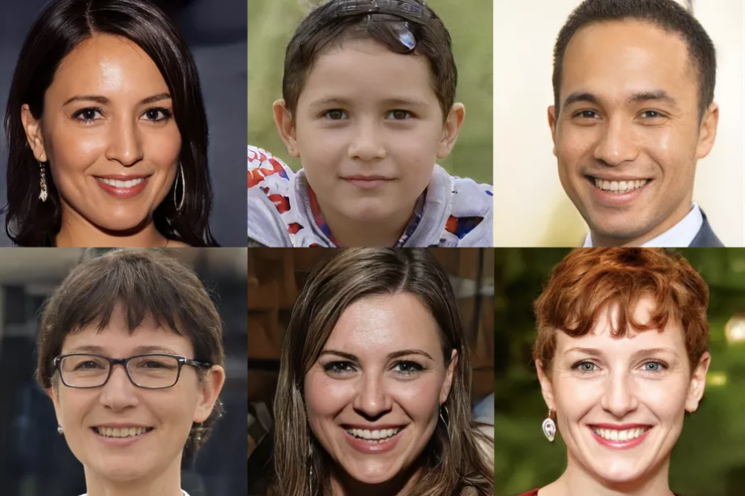

Slide 38
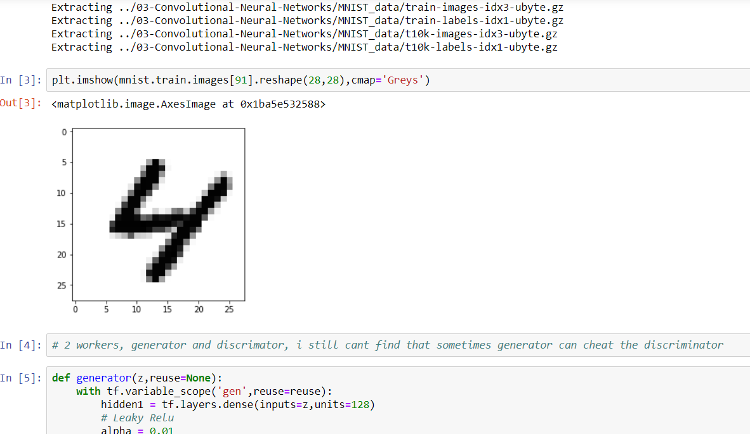

Slide 39
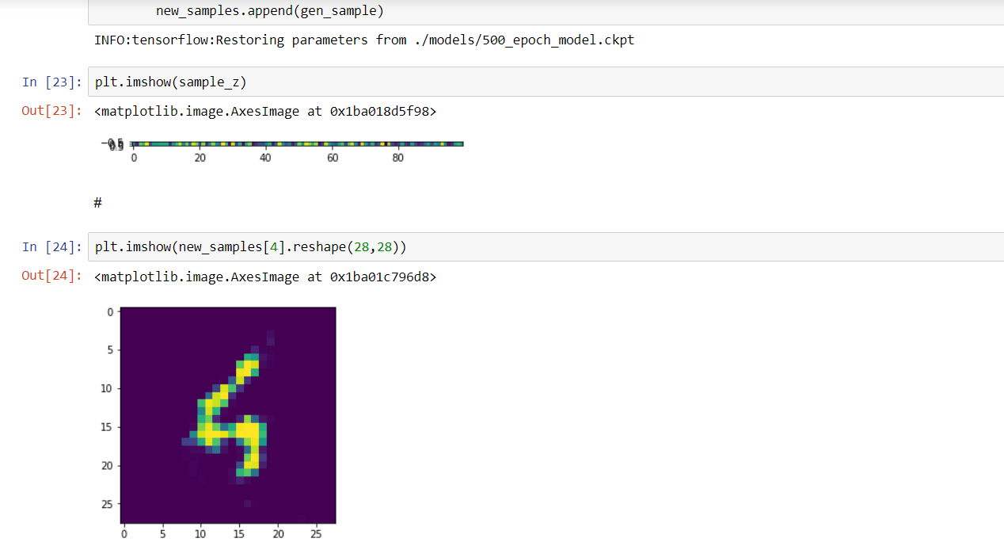

Slide 40
Recurrent Neural Networks
https://magenta.tensorflow.org/assets/sketch_rnn_demo/index.html
Recurrent Neural Network is basically a generalization of feed-forward neural network that has an internal memory.
RNNs are a special kind of NN’s that are designed to handle sequential data.
This can be time series (a list of values of some parameters over a certain period of time, singals, audio)
Very solid approach when you have Natural Language Processing Tasks.
To make a decision, RNN considers the current input and the output that, it has learned from the previous input.

Slide 41
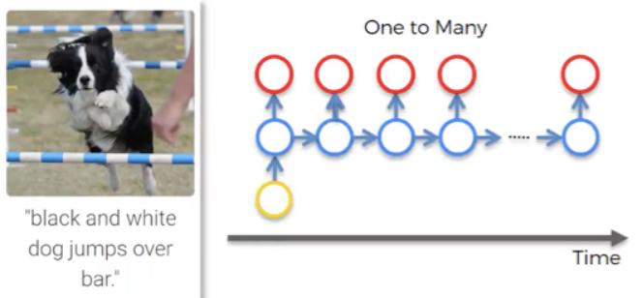
There are different types of RNN’s
One to many
This is a network with one input and multiple outputs.
It could be an image (input), which is described by a computer with words (outputs). You can see such example in the image below.

Slide 42
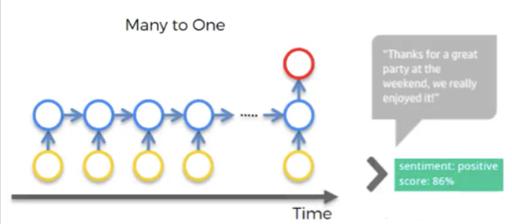
Many to one
An example of this might be sentiment analysis, when you have alot of text, such as a customer’s comment(reviews) and you need to understand what’s the chance that this comment is positive, or how positive this comment actually is, or how negative it is. (moview reviews, product reviews in Amazon etc.

Slide 43
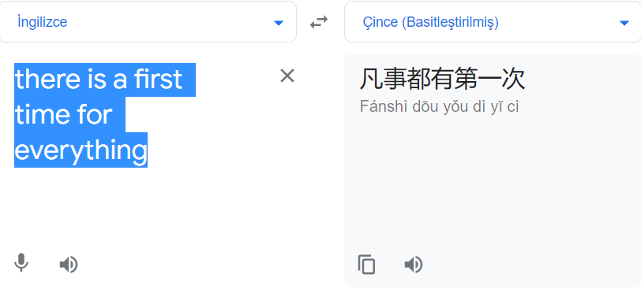
Many to many
Translations can be a good example of many to many type of network. Let’s have a look at a particular instance from Google Translator. We don’t know if Google Translator uses RNNs or not, but the concept remains the same.
Each word below, represents a sequence. Thus translator understands the pattern accordingly.

Slide 44
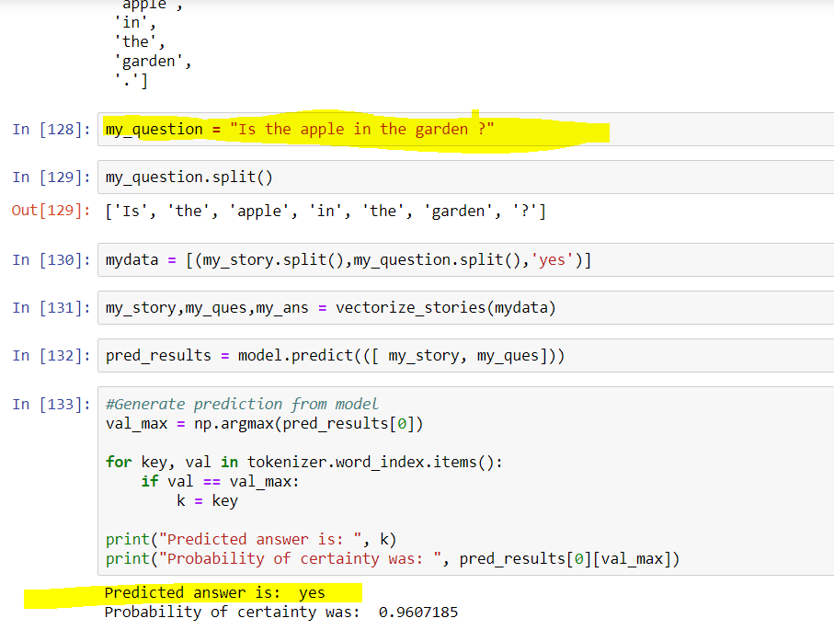

Slide 45
Transfer Learning
Transfer learning (TL) is a research problem in machine learning (ML) that focuses on storing knowledge gained while solving one problem and applying it to a different but related problem. For example, knowledge gained while learning to recognize cars could apply when trying to recognize trucks.

Slide 46
